Slide 1
Super Awesome Evaluation of CPU and GPU Calculated Height Maps for Procedural Terrain Generation
Ben Williams and Kaitlynn Kruse

Slide 2
Libraries
THREE.js
https://github.com/ashima/webgl-noise (GLSL Perlin Noise)
https://github.com/josephg/noisejs (Javascript Perlin Noise)
DAT.gui

Slide 3
Procedural Generation
“Procedural content generation (PCG) is the programmatic generation of game content using a random or pseudo-random process that results in an unpredictable range of possible game play spaces.” - Some Guy on the Internet

Slide 4
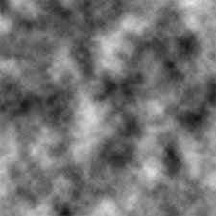
Perlin Noise
Perlin Noise is psuedo-random function that gives a certain Z value for every X,Y pair. It always gives the same Z for every X,Y for any seed N.

Slide 5
CPU Generation
Seed the Perlin Noise
Generate a height map
Create a plane geometry in THREE.js
Specify the number of columns/rows for the map
Set the height of each cell
Smoothly interpolate the height
Recalculate normals and face coloring

Slide 6
GPU Generation
Create a shader material in THREE.js
Pass in the different parameters as uniform’s
Calculate the final height of each point using the GLSL Perlin Noise function in the vertex shader
Color the fragment depending on a varying type passed in
Assign material to a plane geometry

Slide 7
Comparison of CPU vs. GPU Performance
Platform: Linux i7-2620M, 6GB RAM, HD Graphics 3000
Height Map | 100 x 100 | 250 x 250 | 500 x 500 | 750 x 750
CPU | 5 ms | 24 ms | 143 ms | 181 ms
GPU | 50 ms | 490 ms | 1850 ms | 4300 ms

